Slide 1
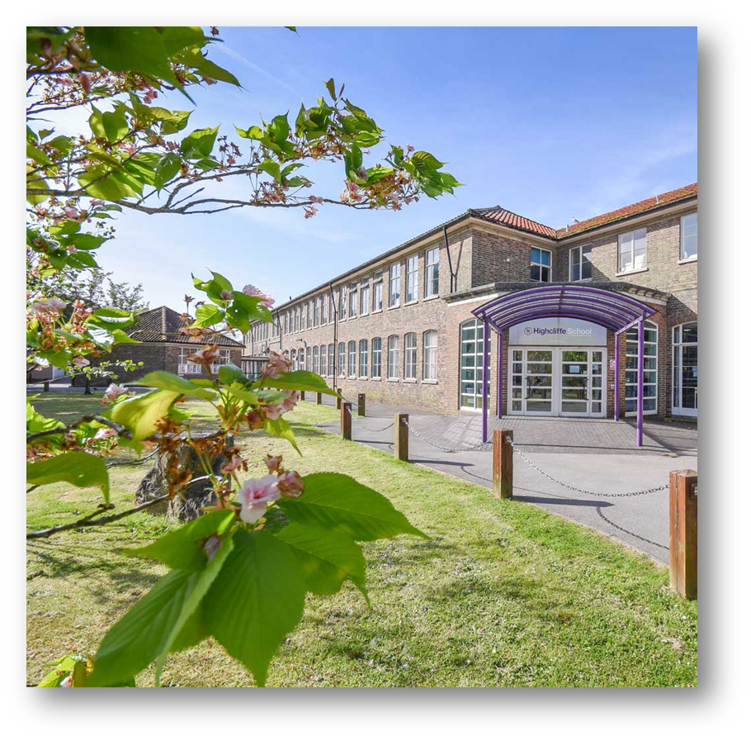
His nature is such that he has to be drawn out by kindness and encouragement but if he be treated well, and love be shown him, he will accomplish things that make the whole world wonder.
Michelangelo, describing himself as a young
art student in 1490AD
Year 11 Information Evening 2023-24

Slide 2
Welcome
Key dates
Highcliffe Lesson – Every Lesson
Sixth Form Information
Learning Journeys and Unit Summaries
GCSE Requirements for success
Core Subjects Information
Passport to Independent Study
Attendance
10. Academic Support

Slide 3
Key Dates
September
21st Y11 Sixth Form Curriculum Seminars begin
21st Open Evening (5:30pm)
28th Careers Fair 3pm - 7pm
October
3rd Sixth Form Open Evening School closes at 2pm
4th INSET DAY 2
10th 11PC1 Issued
23rd – Half Term
Notes:
. Careers Fair – an opportunity for students to explore the different career opportunities that will be available at Post 16 and beyond. This will also include input from local Universities such as Winchester and Bath
11PC1 issued – will factor mock scores and in class assessments that have been completed this year. This will give students and parents a clear understanding go where they are at the start of Year 11. Students will work with staff, including subject teacher and tutor, to greater understand how they can get to the grade that is required.

Slide 4
Key Dates
November
10th Sixth Form Progression Day
23rd KS4 Music Showcase (5.30pm)
27th Year 11 Internal Exams begin
December
7th Year 11 Art Exams begin
13th Year 11 Art Exams end
15th School closes at 12.20PM
Notes:
Year 11 winter mocks begin and run until the 13th. The first of 2 mocks they will undergo this year. This will again give us and students an opportunity to see where students are with their progression through their courses and will help us pick up and misconceptions that have arisen. Allows students to practice being that environment where sustained intense concentration is required to support them in their final GCSE examinations.

Slide 5
Key Dates
January
10th 11 Results Day (Internal)
10th 11PC2 Issued
18th Year 11 Subject Evening
19th Sixth Form Application Deadline
29th Year 11 Progression Meetings Sixth Form Start (2 weeks)
February
5th Year 11 Mock Speaking Exams (up until 21st Feb)
9th Year 10/11 Oxbridge Evening (Study Centre)
29th Year 11 Internal Exams begin
Notes:
Year 11 Results Day – The year group had a very successful Mock Results day at the start of this school year which will mirror what it will be like for them in the summer. The Mock results day just gone was a privilege to be a part of with students showing great enthusiasm and pride with their results. It highlighted that this year group is determined to do well and make the most of Year 11
Year 11 PC2 – the 2nd one of the year, which will be followed by Year 11 Subject Evening where student, parent and staff can talk about the progress made, advise on improvements and set goals with the summer exams on the horizon. Statistics show us that students, should they show the right levels of dedication, can go up a grade and a half from this point so it is an important landmark in the year.
KS4 Oxbridge evening – Some parents may have attended this event last year as it is an open invite to Year 10 and 11 parents. This is an opportunity for students to look at the potential pathway to Oxford and Cambridge University and what the requirements would be to gain access to these prestigious institutions
2nd series of Mocks begin February which is the last one for year 11’s – by this point the focus of in class teaching will be around revision and retrieval practice as course content will have been taught.

Slide 6
Key Dates
March
8th Year 11 Internal Exam exams finish
11th Year 11 GCSE Food Practical begins (ends 18th)
28th End of Spring Term
April
15th ADT GCSE Exams
22nd Geography Pre-release Day
23rd Speaking Exams Begin (finish May 1st)
Notes:
1st GCSE exams begin at the end of April (speaking) – this is the beginning of the exam season with the rest of the exams beginning in May

Slide 7
Key Dates
May
13th GCSE External Exams
24th Year 11 Study Leave Starts
June
21st GCSE External Exams end
July
11th Year 11 Final Assembly and Summer Celebration
Notes:
GCSE exams continue across subjects. Study leave will be afforded to those who meet the requirements after the half term. Exams will finish on the 21st of June.
To finish the year we will be celebrating our year 11 with a final assembly in school before the Summer celebration in the evening which will be at the vitality stadium in Bournemouth. This is an amazing opportunity for students and staff to celebrate the journey and success of year 11 and attendance for this event is always very high.

Slide 8
“
His nature is such that he has to be drawn out by kindness and encouragement but if he be treated well, and love be shown him, he will accomplish things that make the whole world wonder.
Michelangelo, describing himself as a young
art student in 1490AD
”
Year 11 Information Evening Highcliffe Lesson – Every Lesson

Slide 9
Every lesson at Highcliffe School we have the school’s core principles at heart;
Respectful
Responsible
Purposeful

Slide 10
Retrieval Practice
Pulling the information from your long-term memory back into your working memory.

Slide 11
“
His nature is such that he has to be drawn out by kindness and encouragement but if he be treated well, and love be shown him, he will accomplish things that make the whole world wonder.
Michelangelo, describing himself as a young
art student in 1490AD
”
Year 11 Information Evening Highcliffe Sixth Form
Miss Swan

Slide 13
Supporting your Career pathway
UPCOMING EVENTS
TUTOR TIME
CURRICULUM
SEMINARS
SIXTH FORM OPEN
EVENING
SIXTH FORM STUDENT OPEN
DAY
PROGRESSION GUIDANCE
MEETINGS
21st SEPTEMBER
TO
6th OCTOBER
TUESDAY
^{3rd} OCTOBER
5:30PM – 8PM
FRIDAY 10th NOVEMBER
8:35AM – 3PM
JANUARY
AND
FEBRUARY 2024

Slide 15
Do your research…
What subjects do I enjoy?
How is the course structured? Exam V Coursework?
What type of learning is required? Essays? Practical? Factual? What may be the challenges the course will present to me?
Which subjects and topics am I strongest at?
What do I need for my chosen career pathway?

Slide 17
“
His nature is such that he has to be drawn out by kindness and encouragement but if he be treated well, and love be shown him, he will accomplish things that make the whole world wonder.
Michelangelo, describing himself as a young
art student in 1490AD
”
Year 11 Information Evening
Hannah Stedmon – Senior Leadership Team
KS4 Requirements for success, Unit Summaries and Learning Journeys

Slide 18
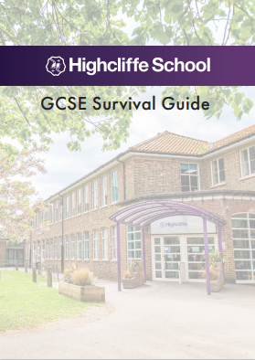
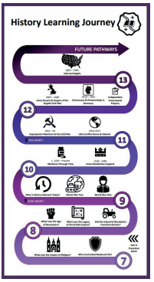
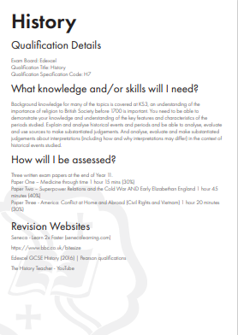
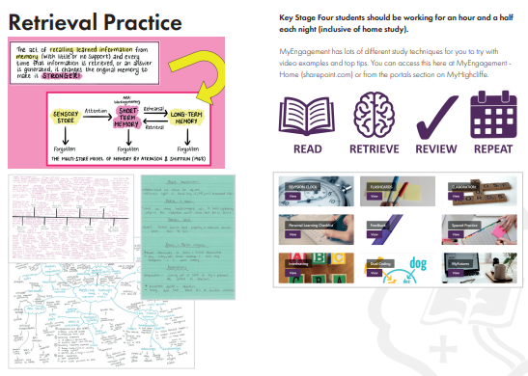

Slide 19
Learning Journeys

Slide 20
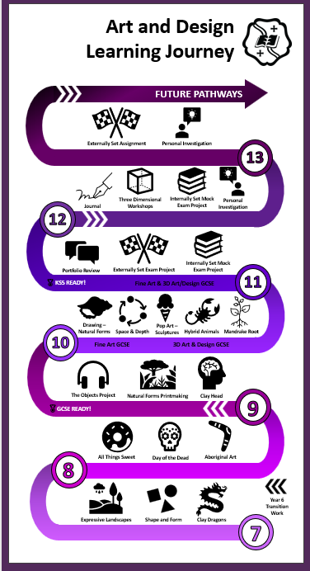
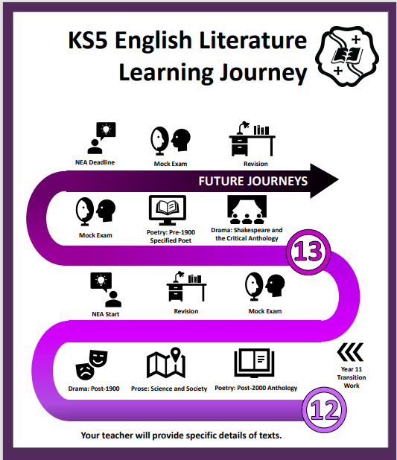
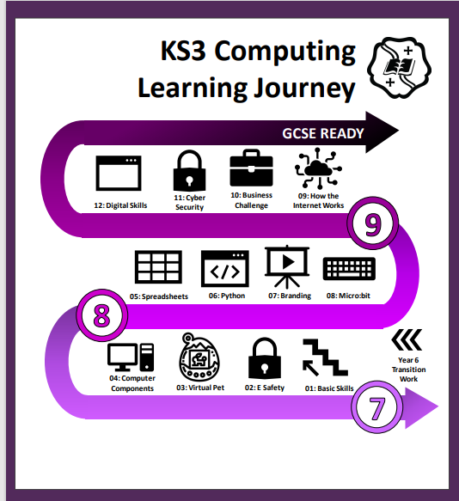
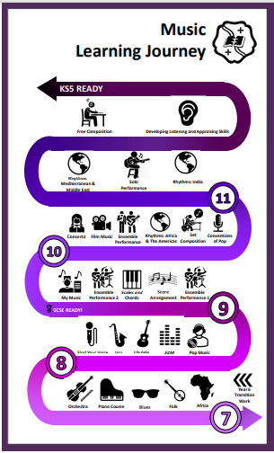
YOUR Learning Journey

Slide 21
Why is it important in Y11?
Students are at the end of their GCSE journey and will leave at the end of the year “future ready”.
They can reflect on what they have they have already learned and what they need to know for your exams.
Students can also start to think about if each subject is something they would like to continue to study at A Level.

Slide 22
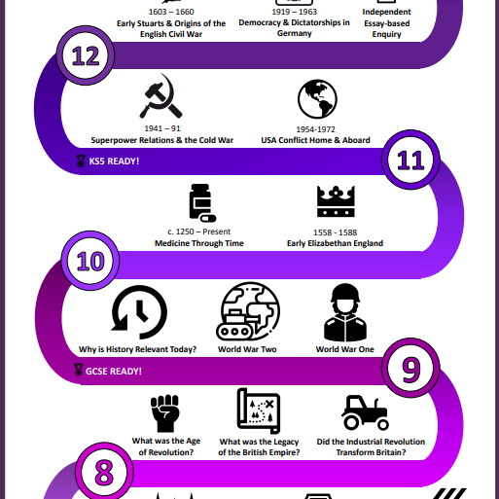
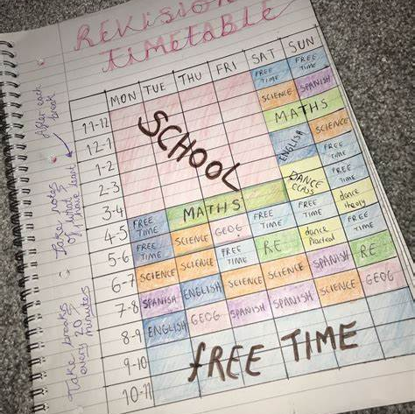
Revision preparation
What topics have I studied?
What do I need to know?
What will I need to know?

Slide 23
Highlighting CONNECTIONS
Studied in more depth at
GCSE
Similar skills as Year 9 Assessment
Y9 work links to Y12 Trip
Important for A Level
Links to Y8 Trip
Studied in more depth at
A Level
Important for GCSE

Slide 24
Unit Summaries

Slide 25
Unit Summaries
What will we learn?
Why this? Why Now?
Key Vocabulary
Wider Study
Assessment

Slide 26
Unit Summaries
What will we learn?
Key Content
Big Questions
What do you need to know?

Slide 27
Unit Summaries
What is the point of learning this topic?
Does it relate to anything studied before?
Does it relate to anything you will go on to study?
Why do you need to study this?

Slide 28
Unit Summaries
What are the key words you need for this unit?
Are you using them in your work?
Do you know what they mean?
Can you spell them correctly?

Slide 29
Unit Summaries

Slide 30
Unit Summaries
How will you be assessed?
When will you be assessed?
What will you be assessed on?
How should you prepare?

Slide 31
“
His nature is such that he has to be drawn out by kindness and encouragement but if he be treated well, and love be shown him, he will accomplish things that make the whole world wonder.
Michelangelo, describing himself as a young
art student in 1490AD
”
Year 11 English Mr James

Slide 32
AQA GCSE ENGLISH
ENGLISH LANGUAGE (8700)
ENGLISH LITERATURE (8702)
*SPOKEN LANGUAGE AWARD

Slide 33
AQA GCSE ENGLISH
ENGLISH LANGUAGE (8700)

Slide 34
AQA GCSE ENGLISH LANGUAGE
ENGLISH LANGUAGE (8700)
Speaking & Listening
Individual Presentation
Paper 1: Explorations in Creative Reading & Writing (50%) – 1hr 45 minutes
Reading Literary Fiction
Descriptive or Narrative Writing
Paper 2: Writers’ Viewpoints and Perspectives (50%) – 1 hr 45 minutes
Reading Non-Fiction & Literary Non-Fiction
Writing to Present a Viewpoint

Slide 36
Formal Mock Examinations
December mock series:
Paper 2 (full paper)
March mock series:
Paper 1 (full paper)

Slide 37
PAPER 1: OVERVIEW
QUESTION | MARKS | TIME | STUDENT KNOWLEDGE & SKILLS
 |  | 15 mins | READING the QUESTIONS and TEXTS closely
1 | 4 | 5 mins | FINDING and LISTING four key pieces of INFORMATION
2 | 8 | 10 mins | ANALYSING how and why the writer uses LANGUAGE & LANGUAGE TECHNIQUES
3 | 8 | 10 mins | ANALYSING how and why the writer uses STRUCTURE
4 | 20 | 20 mins | PRESENTING a clear OPINION of the writer’s METHODS
5 | 40 | 45 mins | WRITING a DESCRIPTIVE or NARRATIVE piece which: communicates clearly organises information includes a range of vocabulary & sentences demonstrates accurate spelling and punctuation

Slide 38
PAPER 2: OVERVIEW
QUESTION | MARKS | TIME | STUDENT KNOWLEDGE & SKILLS
 |  | 15 mins | READING the QUESTIONS and TEXTS closely
1 | 4 | 5 mins | IDENTIFYING four true statements
2 | 8 | 8 mins | SUMMARISING and SYNTHESISING the differences between texts using EVIDENCE and INFERENCE
3 | 12 | 12 mins | ANALYSING how and why the writer uses LANGUAGE and LANGUAGE TECHNIQUES
4 | 16 | 20 mins | COMPARING the writer’s ATTITUDES and METHODS
5 | 40 | 45 mins | WRITING a OPINION essay which: communicates clearly organises information includes a range of vocabulary & sentences demonstrates accurate spelling and punctuation

Slide 39
TOP TIPS
Answer all the QUESTIONS.
Spend the correct length of TIME on each question.
Look for KEYWORDS in the questions.
Write about the SPECIFIED SECTIONS of the texts.
Organise your answers into PARAGRAPHS.
Provide three DEVELOPED PARAGRAPHS in Q2, Q3 & Q4.
Use SQUID/WHAT HOW WHY to STRUCTURE your responses to Q2, Q3 & Q4.
Meet the WRITING BRIEF in Q5.
Use the full range of PUNCTUATION (! ? - : ;).
RE-READ your Q5 response to check for clarity and accuracy.

Slide 40
LANGUAGE SUPPORT & REVISION
Use support materials to help consolidate, clarify and extend your understanding: books like the CGP and York Notes guides are helpful, as are websites like BBC Bitesize, also videos such as those on Mr Bruff’s YouTube channel.
Keep up your general reading: discuss what you have read e.g. summarise the content, attitudes and perspectives; consider how the writer made you feel and why.
Practise writing: even small sections are helpful. Think about how to make your writing attention-grabbing and memorable, particularly the opening.
Keep and learn a vocabulary list: you can include key terminology from lessons, but also interesting words you come across which you could use in your own writing.
Identify areas of SPaG you find difficult and practise to get them right. There are lots of books and online resources to help with spelling, punctuation and grammar: the BBC Skillswise website is very straightforward to understand.
Revisit any previous exam papers you have completed or look at those on the AQA website.
Drop-in support sessions in school.

Slide 41
AQA GCSE ENGLISH
ENGLISH LITERATURE (8702)

Slide 42
AQA GCSE ENGLISH LITERATURE
ENGLISH LITERATURE (8702) –
Paper 1: Shakespeare and the 19th Century Novel (40%) – 1 hr 45 minutes
Shakespeare Play: Romeo & Juliet or Macbeth or Julius Caesar
19th Century Novel: A Christmas Carol
Paper 2: Modern Texts & Poetry (60%) – 2 hr 15 minutes
Modern Play: An Inspector Calls
Poetry Collection – Power & Conflict
Unseen Poems

Slide 44
Formal Mock Examinations
December mock series:
Paper 1 (Shakespeare/19th Century)
March mock series:
Paper 2 (AIC/Power Poetry/Unseen Poetry)

Slide 45
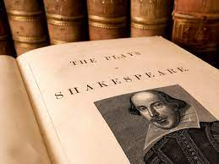
PAPER 1: OVERVIEW
CLOSED BOOK EXAMS – NO TEXTS
SECTION A: Romeo & Juliet or Macbeth or Julius Caesar 55 minutes. An extract to whole text question. Marked /30 plus 4 marks for SPaG.
SECTION B: A Christmas Carol 50 minutes. An extract to whole text question. Marked /30.

Slide 46
PAPER 2: OVERVIEW
CLOSED BOOK EXAMS – NO TEXTS
SECTION A: An Inspector Calls 45 minutes. A whole text question. Marked / 30 plus 4 marks for SPaG.
SECTION B: Power & Conflict Poetry 45 minutes. Comparison question: 1 printed poem and 1 of choice. Marked /30
SECTION C: Unseen Poetry 45 minutes. Part 1: Responding to a printed poem. Marked /24 Part 2: Comparing with another printed poem. Marked /8

Slide 47
LITERATURE SUPPORT & REVISION
Read your texts over again. It can be helpful to have your own copy in which to make notes. Make sure you understand the plot, characters, themes and context.
Make a list of key quotes and learn them.
Use support materials to help consolidate, clarify and extend your understanding: books like the CGP and York Notes guides are helpful, as are websites like No Fear Shakespeare and BBC Bitesize, also videos such as those on Mr Bruff’s YouTube channel.
Use the PixLit app for revision, but bear in mind that while it is a fantastic resource for helping students to remember key quotations and themes, some features are just going to give one singular interpretation of a quotation. This doesn't necessarily mean your interpretation is invalid, but may just not be the one PixLit had in mind.
Lectures from Massolit
Seneca quizzes
Keep and learn a vocabulary list: key terminology from lessons.
Revisit any previous exam papers you have completed or look at those on the AQA website.
Drop-in sessions in school.

Slide 48
“
His nature is such that he has to be drawn out by kindness and encouragement but if he be treated well, and love be shown him, he will accomplish things that make the whole world wonder.
Michelangelo, describing himself as a young
art student in 1490AD
”
Year 11 Information Evening Mathmatics Mr Cooper

Slide 49
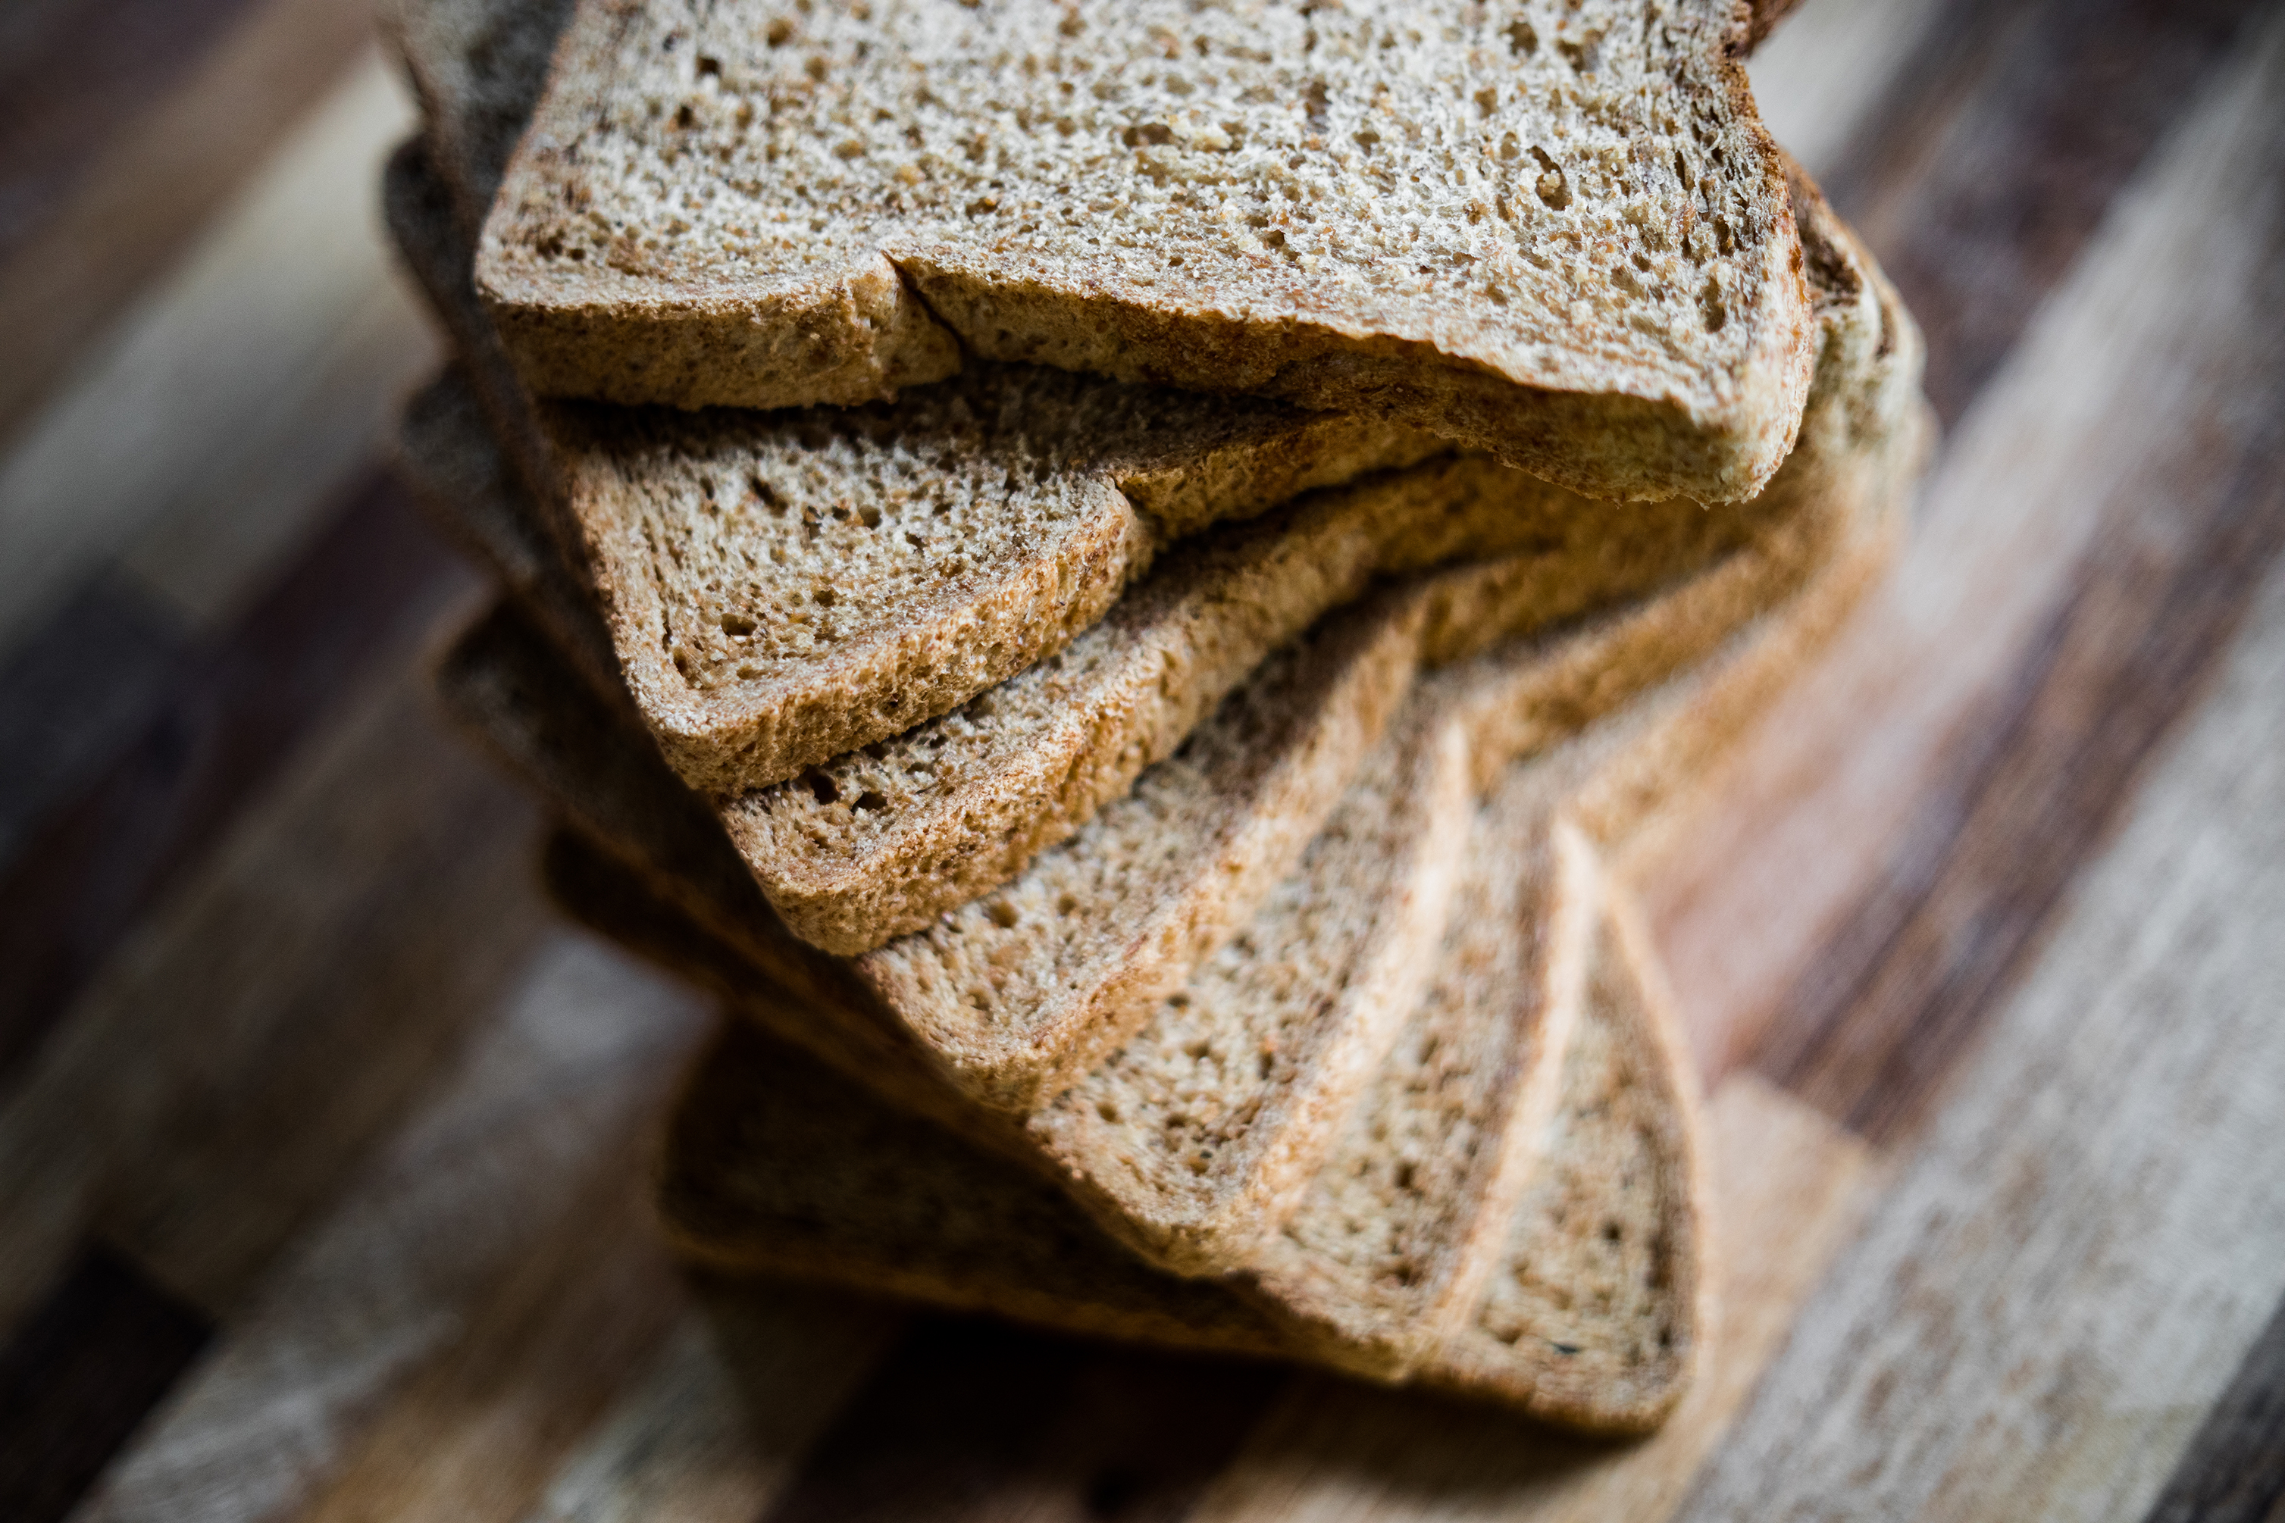
How many slices of bread does the average British person throw away in a lifetime?

Slide 50
Developing a positive attitude towards maths is vital
This sort of question can often be asked at an interview to see how applicants deal with what seems to be an impossible question to answer.
Maths develops the skills needed in order to be able to break down questions such as this into smaller questions you know something about.
This directly relates to GCSE mathematics.
At the core of studying mathematics isn’t necessarily the content, it is a subject that develops critical thinking, creativity and the ability to reason, problem solve and communicate your ideas.
These are key skills employers are looking for regardless of the career type.
How many slices of bread does the average British person throw away in a lifetime?

Slide 51
Grades are important too
Last year around 73% of students sitting GCSE mathematics gained a grade 4 or above.
Students achieving a grade 5 or above drops to around 53% (the grade you need to enter Highcliffe Sixth Form)
Each grade increase drops by around 10-15%, each grade bring you closer to the front of the queue.

Slide 52
Edexcel GCSE (9-1) Mathematics outline
There are 6 strands assessed across mathematics at GCSE:
Number
Algebra
Ratio, proportion and rates of change
Geometry and measures
Probability
Statistics
Two tiers: Foundation and Higher (there is crossover content but also content that appears on the Higher tier that does not appear on Foundation)
Students will take assessments in either Higher or Foundation tier.
Foundation tier: grades 1 to 5
Higher tier: grades 4 to 9 (grade 3 allowed). To be entered into the Higher tier a student should be aiming to gain a grade 6 or above.

Slide 53
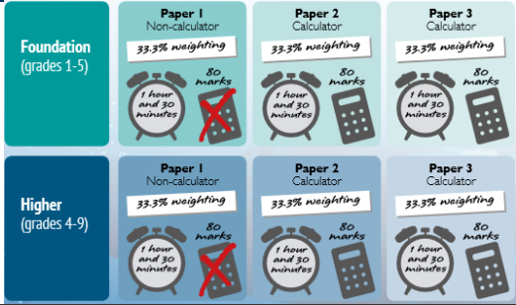
Edexcel GCSE (9-1) Mathematics Exam Structure

Slide 54
Assessment and lessons
Students will sit two full sets of examination papers across the Autumn and Spring terms. In school examination window’s will help to facilitate these mock examinations.
Smaller topic based assessments, retrieval practice and regular homestudy tasks will be used to continually monitor progress.
Content will continue to be covered over the Autumn and early Spring term.
Revision work starts now.

Slide 55
Steps to success
The best way to learn maths is to do maths, little and often is most effective.
Make the best use of lesson time.
Ensure you know how to use your calculator, make sure it is a scientific calculator (we recommend a Casio fx-83GT CW or fx-85GT CW, these are the updated calculators from the Casio fx-83GTX or fx-85GTX)
Complete all homestudy set to the best standard, aim for 100% at hand in.
Regular practice of the fundamentals, arithmetic, algebraic manipulation, learning key vocabulary and formulae not given in the exam.
Ask for help, don’t wait until its too late.

Slide 56
Resources
Revision guides – available through WisePay - £2.70
Dr Frost Maths
Corbett Maths
Maths Genie

Slide 57
“
His nature is such that he has to be drawn out by kindness and encouragement but if he be treated well, and love be shown him, he will accomplish things that make the whole world wonder.
Michelangelo, describing himself as a young
art student in 1490AD
”
Year 11 Information Evening Science – Mrs Chapman

Slide 58
Science GCSEs
9 -1 grades
All linear examinations
6 exams, 2 for each science subject
No coursework, students practical knowledge tested in examinations (15% of questions)
Emphasis on;
- the application of science knowledge
- analysing, interpreting and evaluating skills
- maths skills

Slide 59
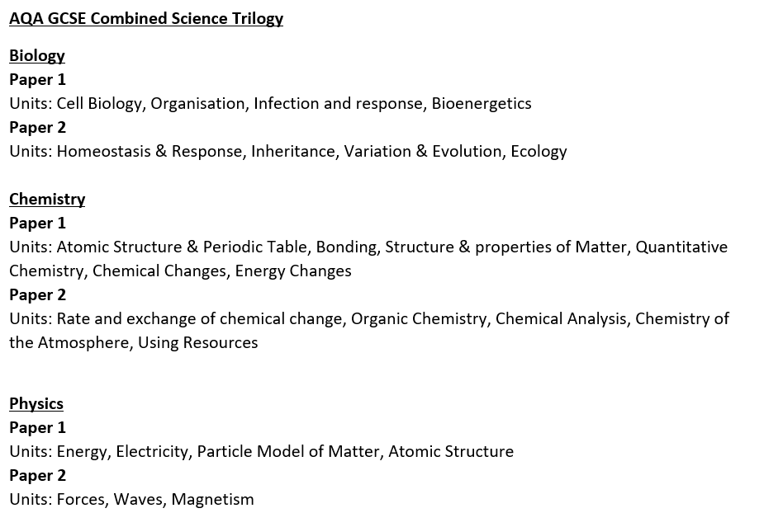
AQA Combined Science Trilogy
2 examinations for each subject, each 1 hour 15 minutes in duration and worth 16.7% of course
2 GCSE grades awarded

Slide 60
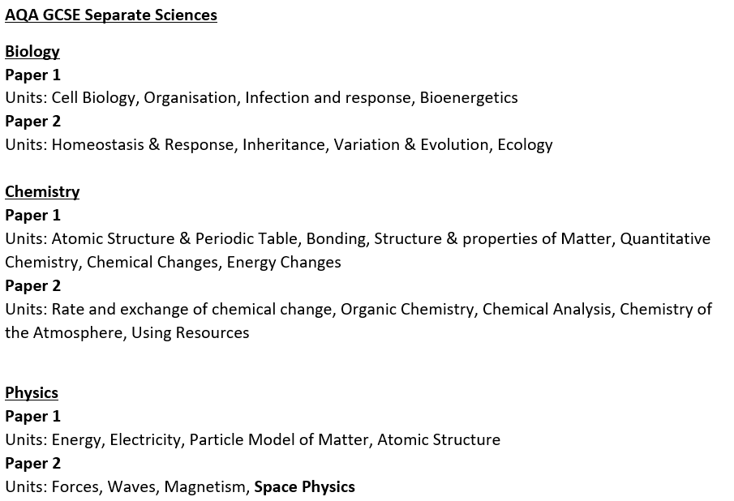
AQA Separate Sciences; Biology, Chemistry & Physics
2 examinations for each subject, each 1 hour 45 minutes in duration and worth 50% of course
3 GCSE grades awarded, 1 for each subject

Slide 61
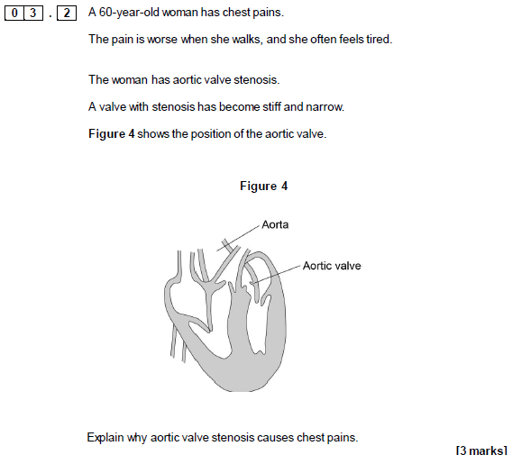
Style of Exam Questions

Slide 62
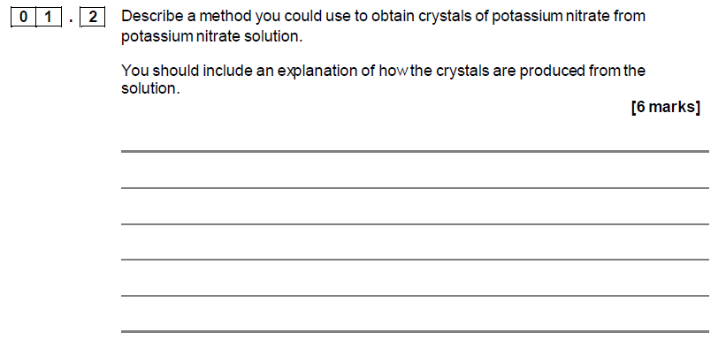
Style of Exam Questions

Slide 63
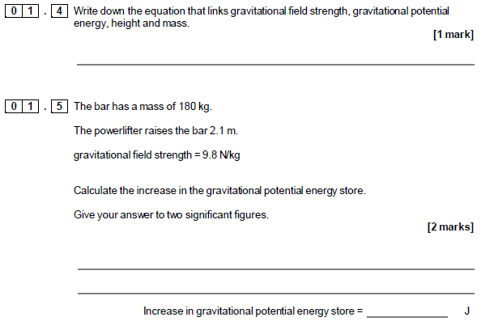
Style of Exam Qs

Slide 64
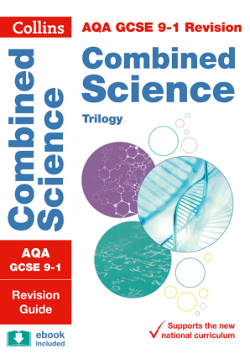
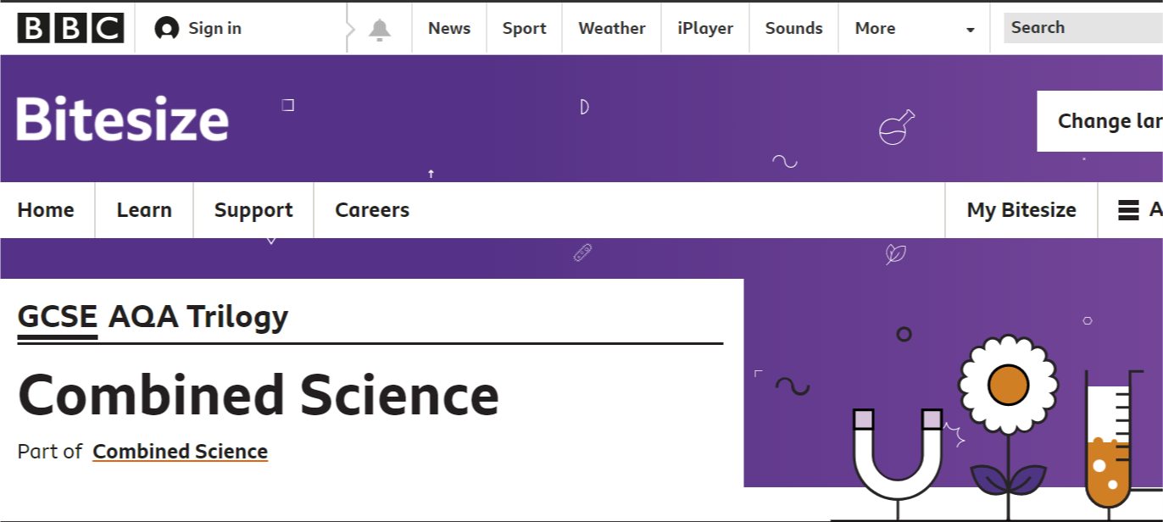
How can you support your child?
Revision guides
BBC Bitesize activities, videos and tests

Slide 65
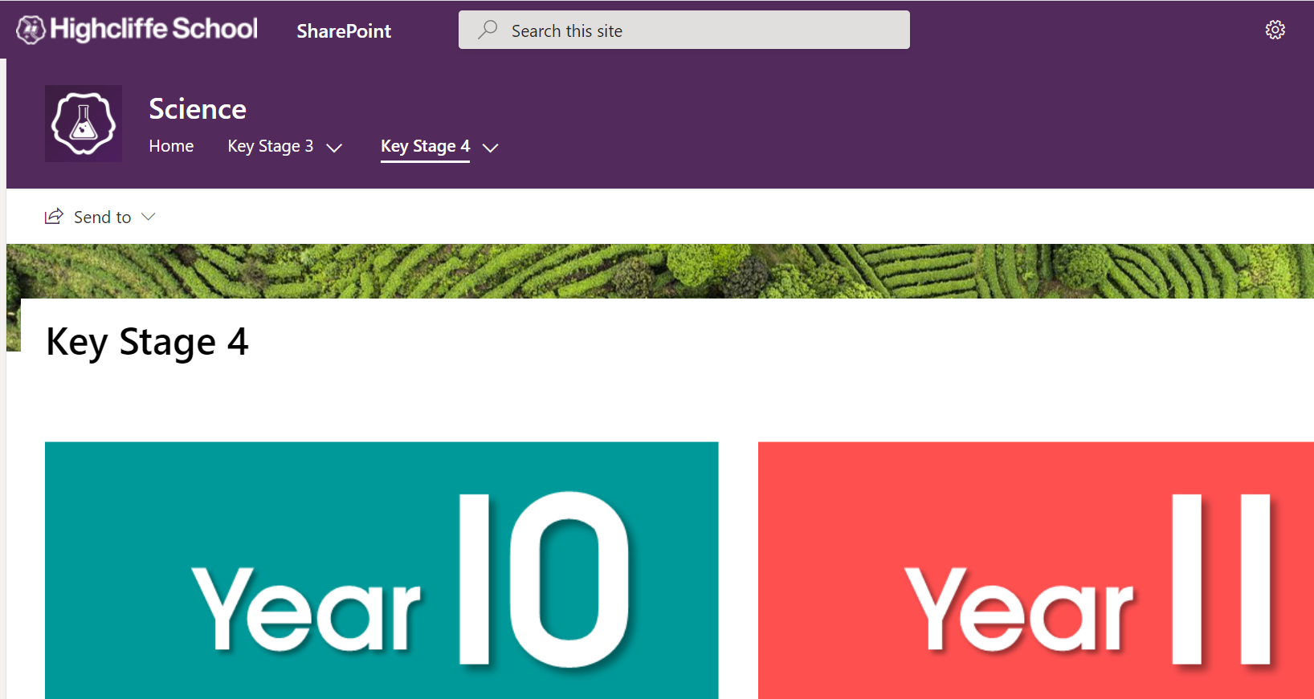
How can you support your child?
Resources on Highcliffe Science SharePoint
Physics formulae in planner, ionic charges and key terminology for practicals in planner

Slide 66
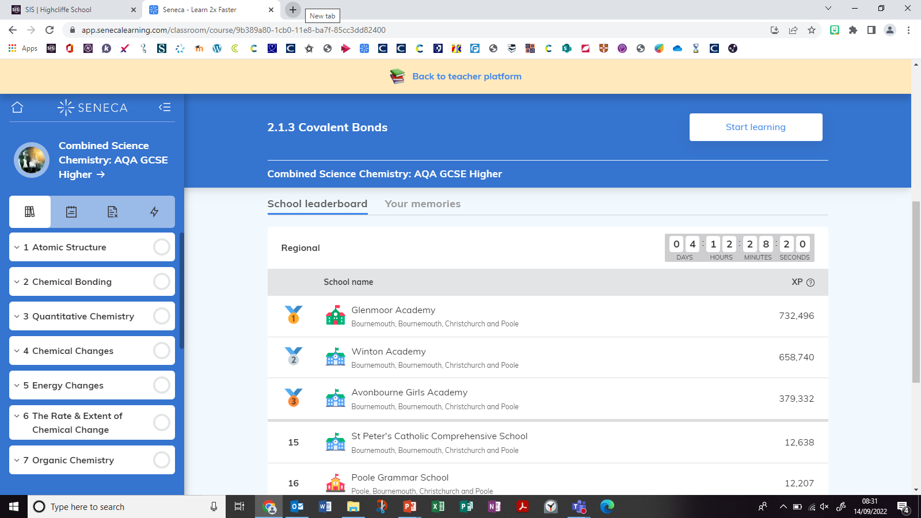
How can you support your child?
SENECA Learning

Slide 67
How can you support your child?
Reviewing Y9 and 10 work regularly, to keep on top of content
Using PLC checklists given for each unit to ensure revision is completed and Unit Summary Sheets to check keywords and Required Practicals for each unit
Watch Required Practical videos for revision and make notes (eg key apparatus used, variables)
Producing revision resources, not just copying out of a book or reading. Revision needs to be active eg making flash cards of keywords and definitions, answering exam Qs in revision guide to check learning
When testing them, ask them to explain concepts, rather than just recall facts

Slide 68
“
His nature is such that he has to be drawn out by kindness and encouragement but if he be treated well, and love be shown him, he will accomplish things that make the whole world wonder.
Michelangelo, describing himself as a young
art student in 1490AD
”
Year 11 Information Evening Passport to Independent Study

Slide 69
Independent Study
The school offers students the opportunity to have independent study at home supported by high quality revision sessions in school (Walking Talking Mocks, Interventions etc.)
By collecting commendations, students can earn the opportunity to study at home rather than in school from a date to be confirmed.
135 commendations required to enable study at home.
MyHighcliffe will enable you to keep track of your total commendations including those based on attendance, ATL and Progress.
Students can of course still decide to come to school if they prefer

Slide 70
Independent Study
Mr Earnshaw has the final say on Study Leave.
If the school feels a student would be better suited to study in school they may be asked to attend.
Parents have to agree to students studying at home.
Students are welcome to continue to study in school and teachers of all subjects will be available during their timetabled lessons.

Slide 71
Earning Commendations

Slide 72
In Timetabled Lessons
Breakthrough in Learning
Actively Engaging in Learning
Demonstrating Initiative in Learning
Helping Others Learn
Demonstrating Consideration for Others
Commendation Letters (5 commendations)

Slide 73
Attitude to Learning
PC1 and PC2
1 commendation for each ATL1 or ATL2

Slide 74
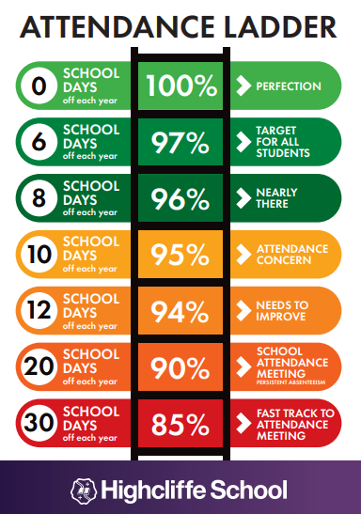
Why is attendance important?
Good attendance is linked to good mental health
It ensures your child has the same opportunities as others
It ensures they don’t miss out on the social side of school and helps maintain friendships
Helps develop good habits for later life
It ensures good educational outcomes
It is the law!

Slide 75
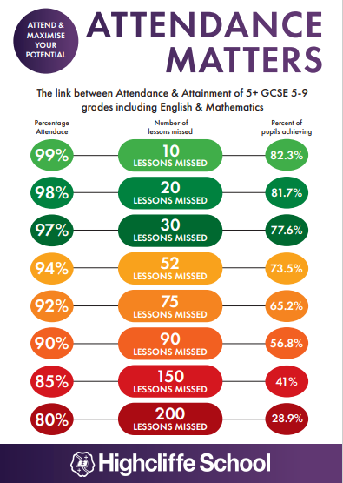
How poor attendance can affect your future.
If your attendance each year is 90% you will have missed 450 lessons over your time in school. At 85% this would be 750 lessons
If you had 100% attendance that would equate to 190 days in school. This still leaves 175 days when your child is not in school which can be used for non urgent appointments
If grades are impacted it will affect your options post 16
Not every student will get grades 5 and above, but every student should have the chance to achieve THEIR potential.

Slide 76
“
His nature is such that he has to be drawn out by kindness and encouragement but if he be treated well, and love be shown him, he will accomplish things that make the whole world wonder.
Michelangelo, describing himself as a young
art student in 1490AD
”
Year 11 Information Evening Academic Support

Slide 77
Revision/Intervention/Boosters
Booster/Revision sessions will be published on the school website
Students will receive regular reminders in tutor and sessions will be advertised on posters around school and on Students MyHighcliffe page

Slide 78
My Futures
My Futures is made up of 3 strands: My Lectures, My Skills and My Workshops.
The aim is to ensure that students have access to a robust range of subject-specific materials that support and facilitate students to independently prepare for assessments at both GCSE and A Level.
By creating a predominantly pre-recorded collection of subject material, it provides a central structure for support which will help minimise students having to choose between subject support sessions, due to a lack of time or availability to attend afterschool sessions.

Slide 79
My Futures
Students will be able to access My Futures through the portal on MyHighcliffe and will only see the content relevant to the subjects they are studying.
My Lectures and My Skills pre-recorded material has been released from a range of subjects to allow students to more effectively plan their independent study timetable.
Students will be able to claim a commendation for attending in school or online My Workshop sessions or once they have watched the pre-recorded material in the case of My Lectures and My Skills.
Parents should also be able to access these sessions through the parent portal on MyHighcliffe.
Notes:
All the information from this power point will be put out to you via email and the student requirement for success booklet will be sent to all KS4 students.
Thank you for continued support and thank you for attending this evening.

